Slide 1
OpenAIRE: the European Scholarly Communication Infrastructure
Paolo Manghi
Consiglio Nazionale delle Ricerche
Istituto di Scienza e Tecnologie dell’Informazione
OCLC Research Workshop
Libraries and Research: Supporting Change/Changing Support
June 10th-12th, 2014 - Amsterdam, The Netherlands

Slide 2
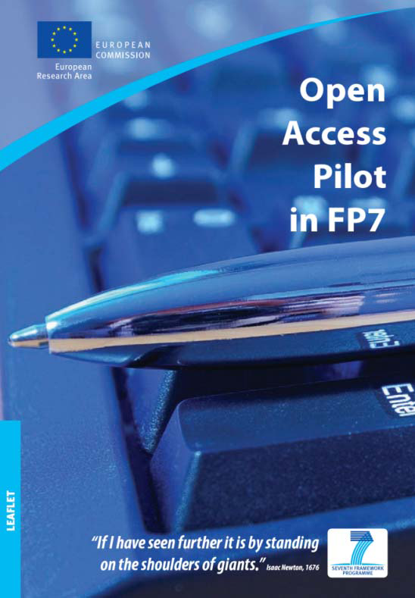
OA EU Pilot (2009)
Support EC’s and ERC Open Access policy
Grant agreement SC39
20% programme areas
Deposit in Repositories
OA after embargo period (6-12 months)
Gold payments during project
Widest possible dissemination and access to research outputs through the creation and operation of an Open Access Infrastructure for Research in Europe

Slide 3

OpenAIRE
Open Access Infrastructure for Research in Europe
Infrastructure for the identification, deposition, access, and monitoring of FP7 and ERC funded articles and compliance to OA mandates
2009 – 2012
Point of reference for Open Access in Europe

Slide 4

OpenAIREPlus
Open Access Infrastructure for Research in Europe
Extended
Any OA article
Any EU and National Funding Scheme
Publications in context (datasets,
projects, funding schemes, people, etc.)
2011 – 2014

Slide 5

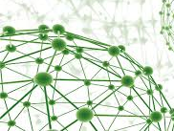
OpenAIRE infrastructure
Human Network
e-Infrastructure

Slide 6
A participatory approach
Capitalizing on previous investment
Repositories
Technologies
Organizations
people

Slide 7
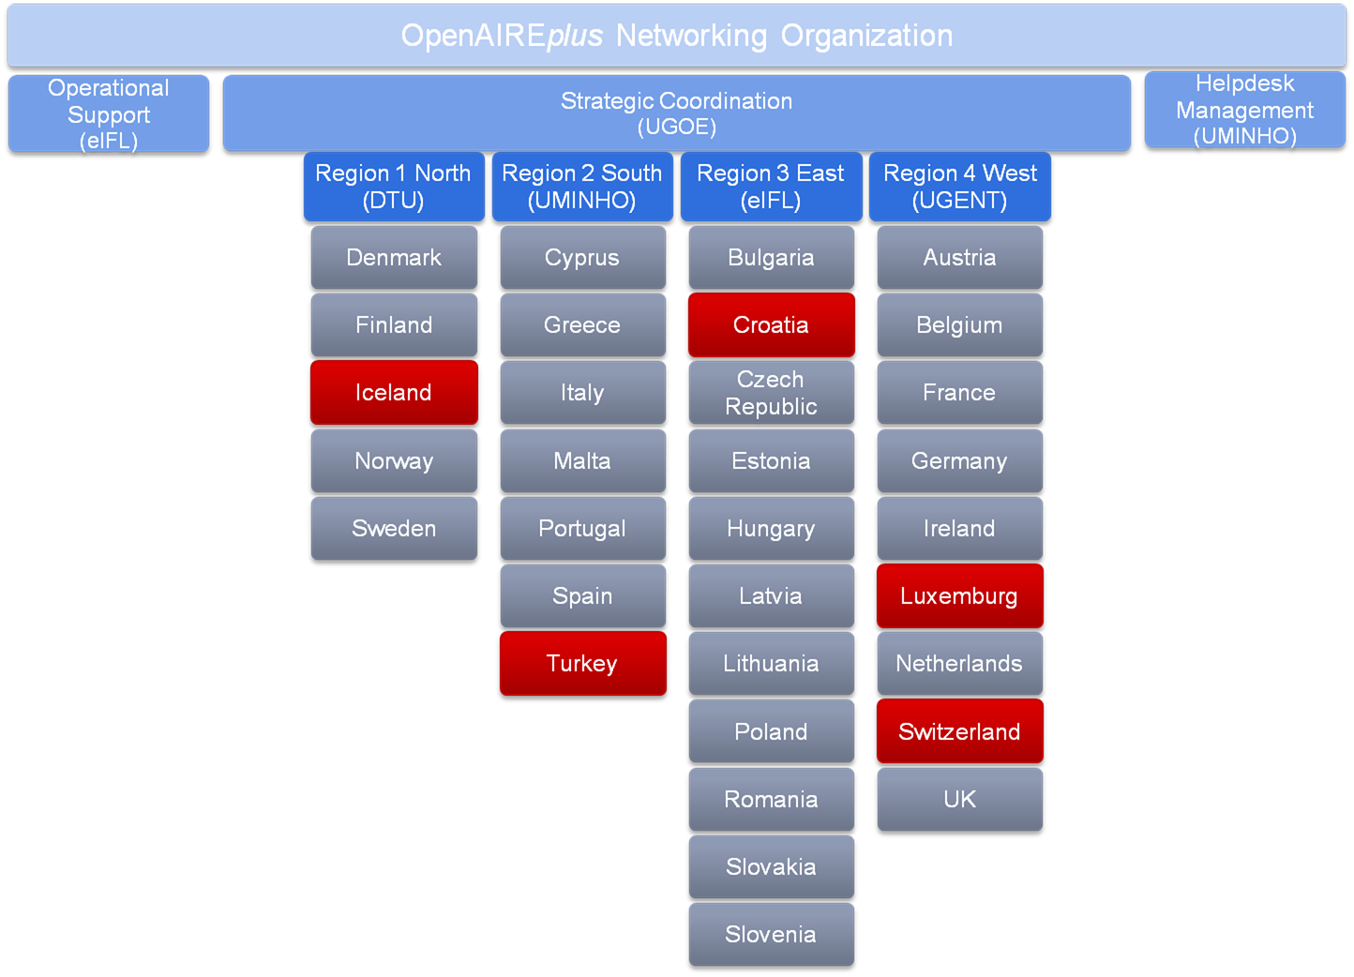
Supporting OA in Europe
OpenAIRE representing all Member States
32 National Open Access Desks
  Involving the research libraries
  Diverse national research environments
OA advocacy through targeted activities
  Liaison with National Reference Points
  Helpdesk, workshops, training
Harmonisation of OA policies
Definition of shared guidelines
Croatia

Slide 8

OpenAIRE Guidelines
Literature Repository, Data Archive and CRIS managers
GUIDELINES FOR LITERATURE REPOSITORIES
based on Dublin Core
GUIDELINES FOR DATA REPOSITORIES
based on Datacite
GUIDELINES FOR CRIS MANAGERS
based on CERIF
http://guidelines.openaire.eu

Slide 9



What is OpenAIRE: end-user perspective
SUPPORT
Helpdesk. Engaging people and scientific repositories in 28 EU member states and beyond
PORTAL
24 x 7 Service. Access to Research records. Linking publications to datasets, author information and above all, funding information
ZENODO
Repository for data and articles that can be stored neither in institutional nor in subject-based/thematic repositories

Slide 10
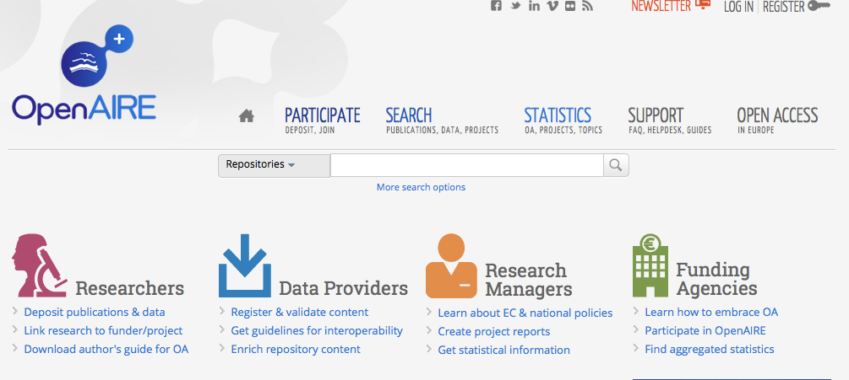
OpenAIRE Portal and Services

Slide 11



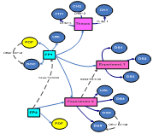








Deposit Publications
& data
Visualize - Manage
Enhanced Publications
Curate & collaborate
Research impact
Citations, usage statistics
+++
Search & Browse
Linked Content
Statistics
+++
Get support
(NOADs)
Guidelines for use services
De-duplicate
Cite
Link
Text Mine
Classify
APIs
Guidelines for data interoperability
Metadata
And pdfs
Usage data
Metadata
on data
Institutional
CRIS Systems
EC funding
National funding
Publication repositories
Institutional & Thematic
Open Access Journals
ResearchID
OpenDOAR
Data repositories
Data Journals
CERN/OpenAIRE “catch-all” repository
Notes:
Publications from OA repositories
Links to any funding information
Links them to data repositories
Integrating national research systems
Produces new knowledge / service
Monitoring for research administrators

Slide 12

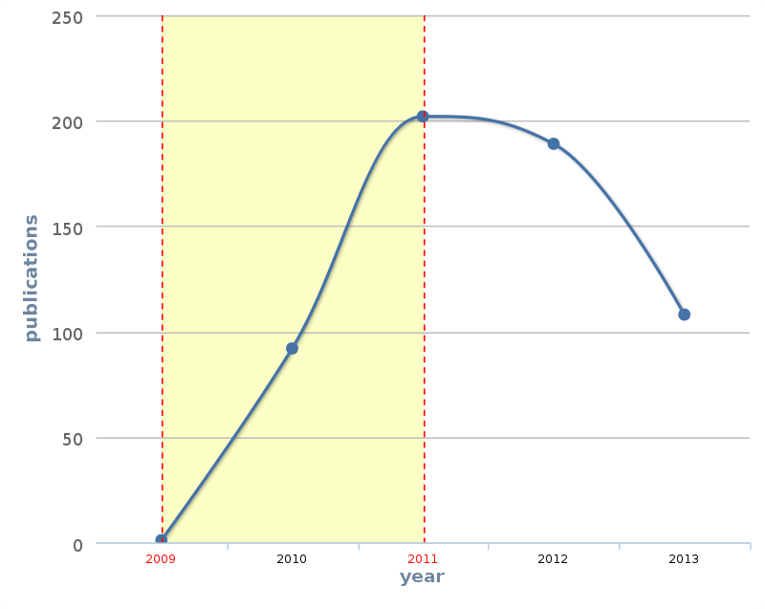
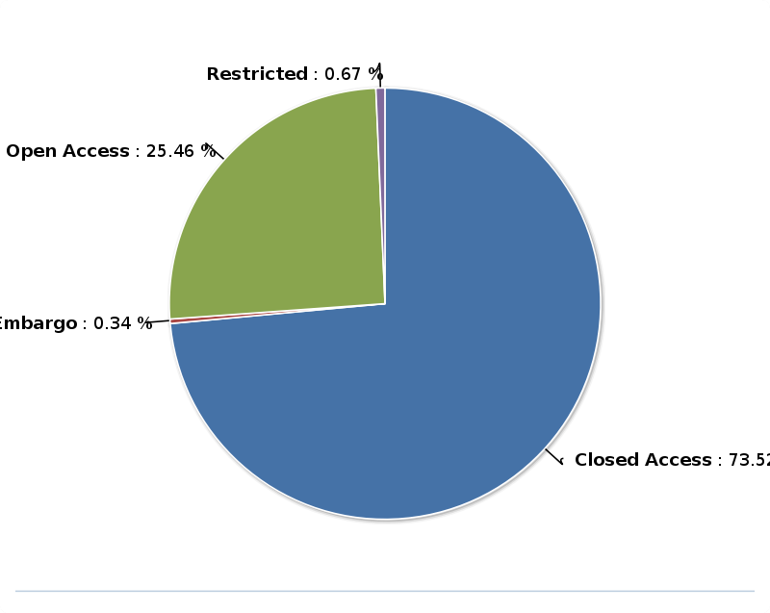
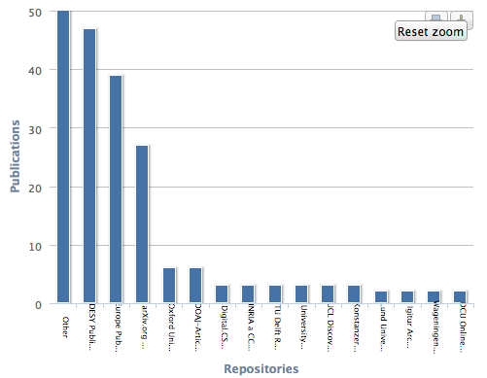
Project statistics
OA mandate conformance
Project productivity over time
Post project-end monitoring
Pubs location

Slide 13

OpenAIRE Data flow
Enriched Information
Space
Data
Inference
End-user Data
Curation
OpenAIRE
Portal:
Discovery & Impact measure
Public
Information Space
De-duplication
Native
Information Space
Data source import
End-user claims

Slide 14
Importing from data sources
Publication Repositories
  Institutional, Journal’s and thematic
Data repositories
  Data Center’s and thematic
Aggregators
  Repositories, e.g. NARCIS,
  Journals, e.g. DOAJ, Copernicus
  Datasets, e.g. DataCite
Entity registries (rewarding-reusing efforts of other initiatives)
  OpenDOAR, CORDA, ORCID, re3data.org, Wellcome Trust
CRIS systems
  Institutional and national

Slide 15
Importing from end-users
Depositing, claiming, feedback
OpenAIRE Zenodo Deposition: authors who are orphans of a repository of reference for publication and datasets can deposit file and metadata into the Zenodo repository
CrossRef Claiming: authors who have a repository of reference can “claim” their depositions into OpenAIRE by specifying the relative DOIs
Data Curation: OpenAIRE data curators (and registered end-user feedbacks, prior validation from data curators) can enrich or fix the information space

Slide 16
Importing from inference
Examples
Relationship inference by mining publication PDFs
  Project-publication: EC and National projects (e.g. WT)
  Dataset-publication: DOI connections
  Publication-publication: citations by bibliography, text similarity
Property inference by mining publication PDFs
  Title of papers
  Authors of papers
  Affiliating organizations of the authors at time of publication
  Subject classification

Slide 17

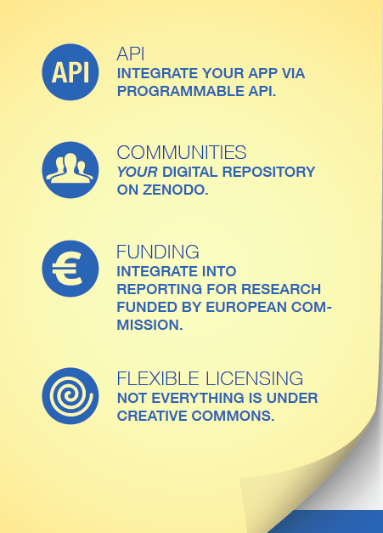
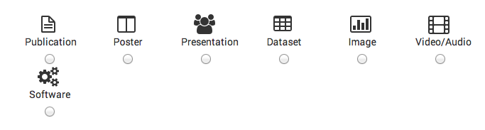
Zenodo
“Catch-all” repository: OpenAIRE-CERN joint effort
Multiple data types
  Publications
  Long tail of research data
Citable data (DOI)
Links to funding, pubs, data, software
www.zenodo.org
  H2020: Option to gather, preserve and share
  your project’s scientific output

Slide 18
Some numbers (June 6th, 2014)
8.3 mi publications
7 mi authors
460+ data providers
Linked to 80K projects from
2 funders (EC and Wellcome Trust)
Linked to 600+ datasets
33K organizations
Datasets
Persons
Publications
Data Providers
Projects
Organizations

Slide 19
OpenAIRE & COAR: Other regions
Australia
(RDA-ANDS)
Canada
( )
United States
(SHARE)
Cina
(CAS)
Europe
(OpenAIRE)
South America
(LaReferencia)
Aligning Repository Networks
Meeting, 20-21 March 2014,
CNR, Roma

Slide 20
EC OA Mandate Progression
FP7 OA Pilot (2009)
Grant agreement SC39
20% programme areas
Deposit in Repositories
OA after embargo period (6-12 months)
Gold payments during project
Horizon 2020 (2014)
All grant agreements
100% programme areas
Deposit in Repositories
Gold payments after project end
Open Data Pilot for a number of programme areas

Slide 21
OpenAIRE in H2020
EINFRA-2-2014 – e-Infrastructure for Open Access
Richer variety of research products…
  ….. Service-driven data e-infrastructure responding to general and specific requirements of researchers and research organisations for open access to and deposit of scientific information (including journal articles, books, monographs, conference proceedings, thesis, grey literature, software and data, as well as services linking literature, data and software).
… and services
  …..collecting bibliometric data on publications, citations, data citations, etc. on all Horizon 2020 scientific output (including on the Open Data Pilot) and produce both standard and on-demand statistics.

Slide 22
paolo.manghi@isti.cnr.it
©2014 Paolo Manghi. This work is licensed under a Creative Commons Attribution 3.0 Unported License. Suggested attribution: “This work uses content from "OpenAIRE: the European Scholarly Communication Infrastructure" © Paolo Manghi, used under a Creative Commons Attribution license: http://creativecommons.org/licenses/by/3.0/”

